Slide 1
QUALE INTERVENTO IN CASO DI GERD POST-OPERATORIO?
SEMPRE RYGB?
DR. GIACOMO PIATTO
UOC CHIRURGIA GENERALE E D’URGENZA
OSPEDALE DI MONTEBELLUNA (TV)

Slide 2


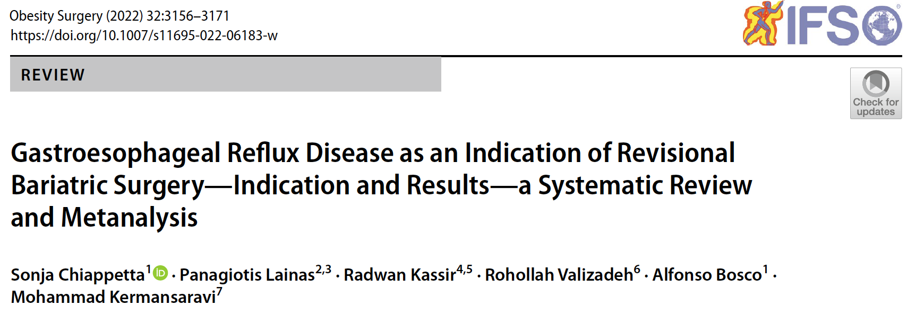
OVERVIEW (1)

Slide 3
OVERVIEW (2)
48 PAPERS, 17437 PATIENTS
915 PATIENTS TREATED WITH REVISIONAL BARIATRIC SURGERY (RBS)
PRIOR SURGERY: 87% SLEEVE, 6.8% OAGB
INDICATIONS: GERD 71.6%, GERD + WEIGHT ISSUES 16%, BILE REFLUX 6.2%
OVERALL 7% OF GERD AFTER PRIMARY SURGERY REQUIRING RBS
REVISIONAL SURGERY: 73.2% RYGB, RYGB + HHR, OAGB, RE-SG, SEROMYOTOMY
RESULTS: 99% REMISSION OF GERD

Slide 4
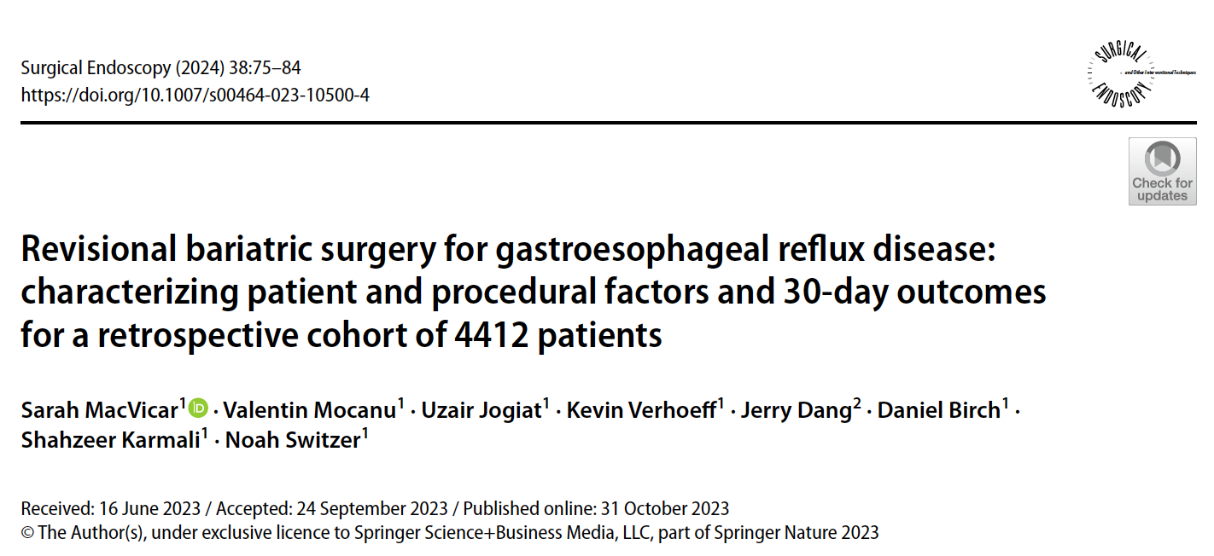
OVERVIEW (3)

Slide 5
OVERVIEW (4)
DATA FROM THE METABOLIC AND BARIATRIC SURGERY ACCREDITATION AND QUALITY IMPROVEMENT PROGRAM (MBSAQIP)
INDICATION: REVISIONAL SURGERY FOR GERD IN 2020
4412 PATIENTS (24% OF ENTIRE REVISIONAL PROCEDURES)
PPI USE 84.1%
PRIOR SURGERY: 80.1% SLEEVE, 15.4% GASTRIC BAND
REVISIONAL SURGERY: 89.3% RYGB, 7.1% SLEEVE, 1.2% OAGB
30 DAYS OUTCOME: RE-OPERATION 3.8%, MORTALITY 0.2%

Slide 6
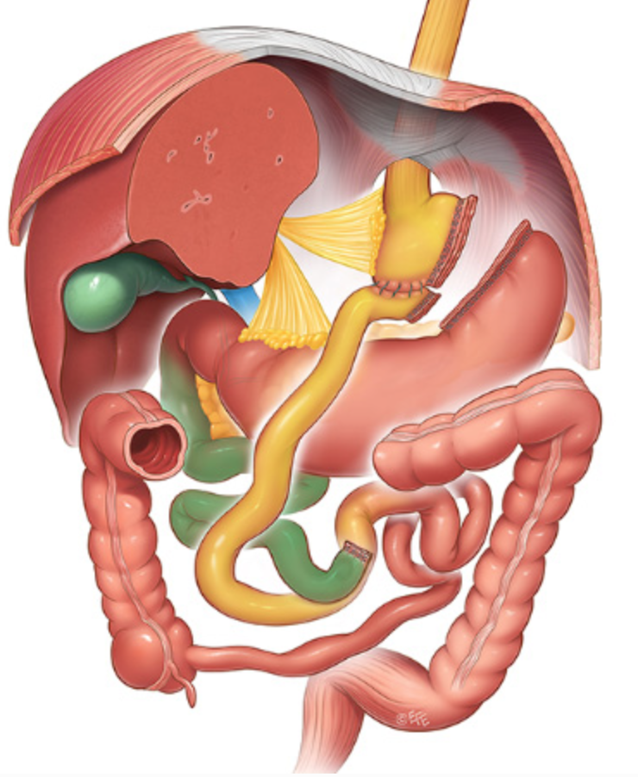
WHY ROUX-EN-Y? (1)
SMALL GASTRIC POUCH → MINIMAL ACID PRODUCTION
ABSENCE OF PYLORUS → NO LAPLACE EFFECT
ROUX LIMB → NO BILE REFLUX

Slide 7
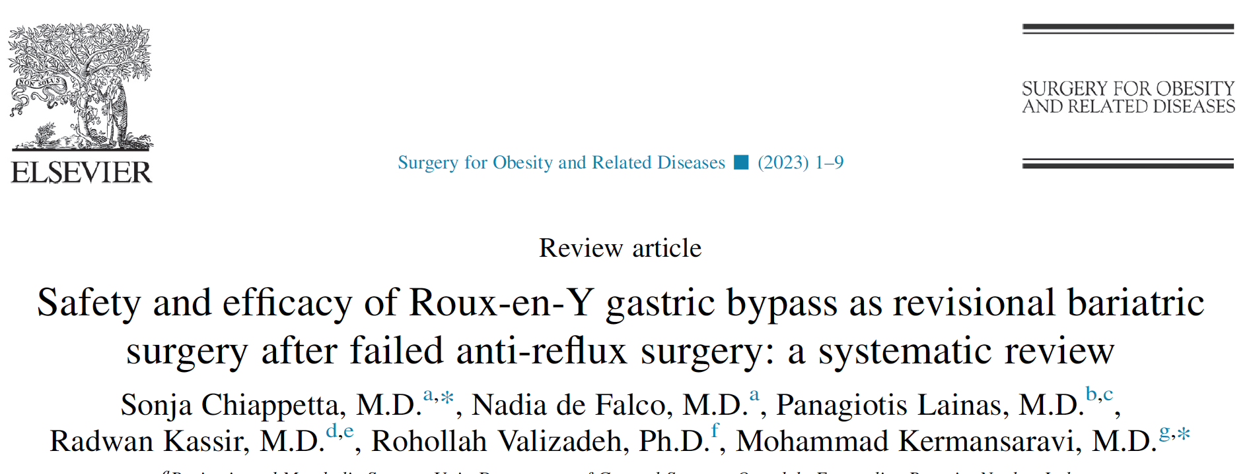
WHY ROUX-EN Y? (2)
874 RYGB AFTER FAILED ANTIREFLUX SURGERY (NISSEN)
GERD IMPROVEMENT 92.6% (F-UP 25 MONTHS)

Slide 8
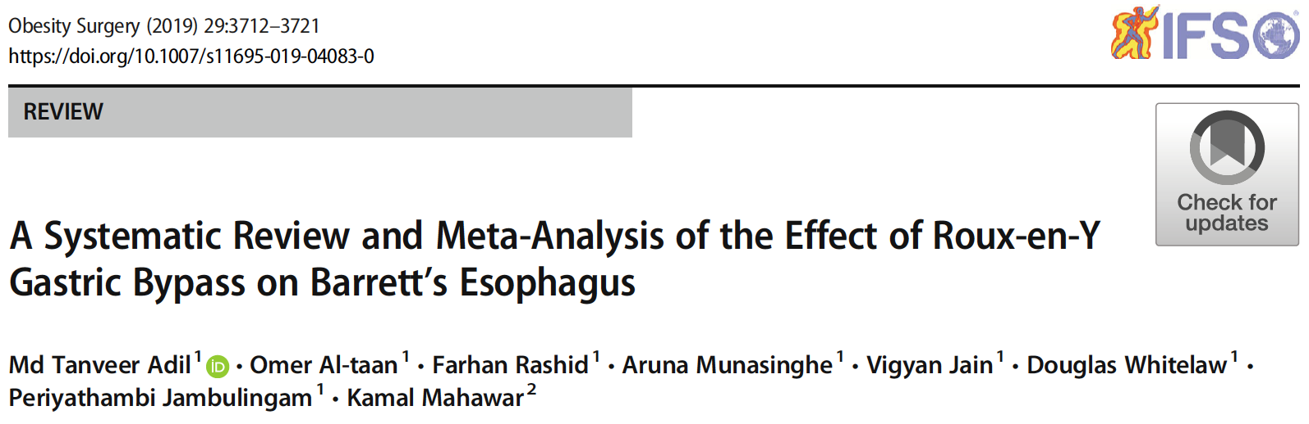
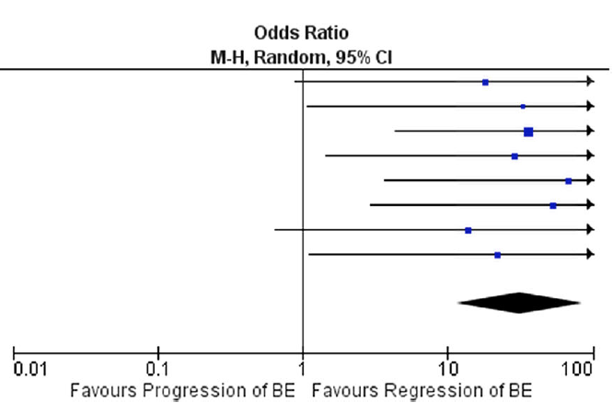
WHY ROUX-EN Y? (3)
10779 RYGB
117 BARRETT

Slide 9
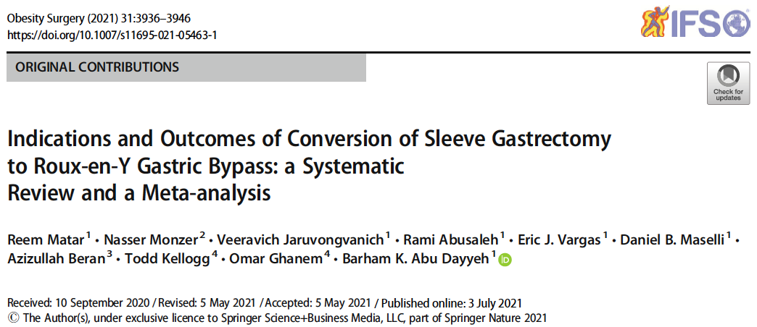
SG TO RYGB FOR GERD (1)

Slide 10
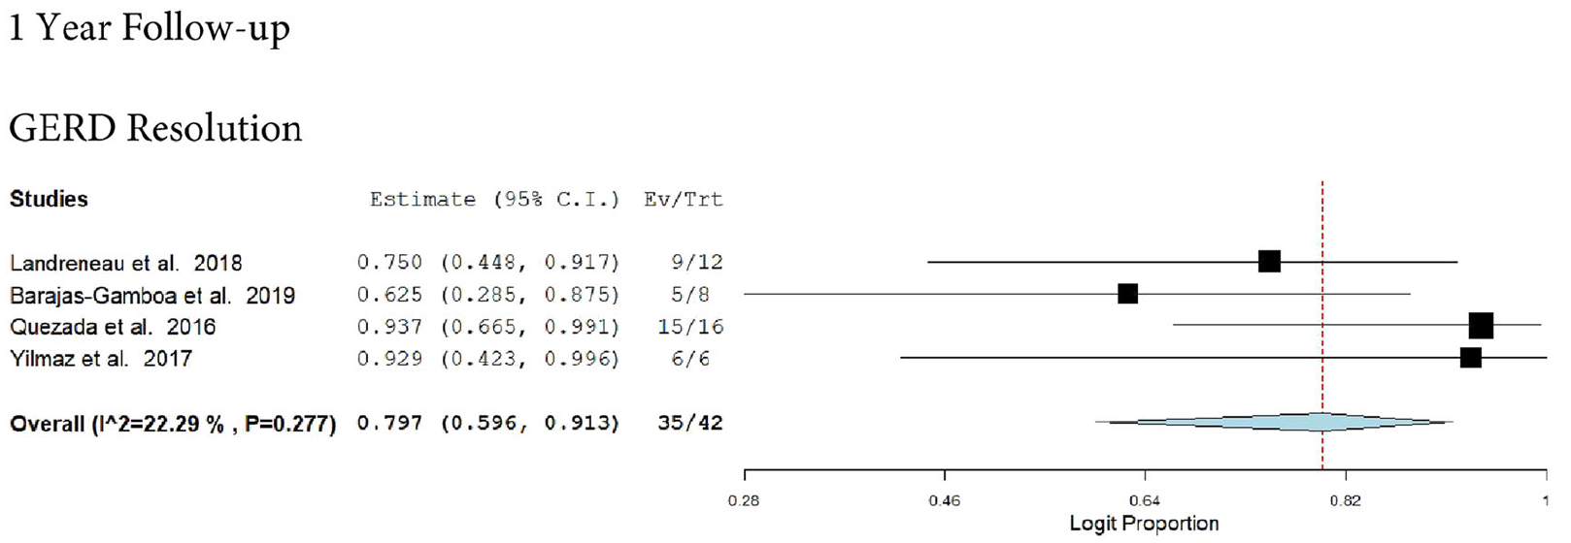
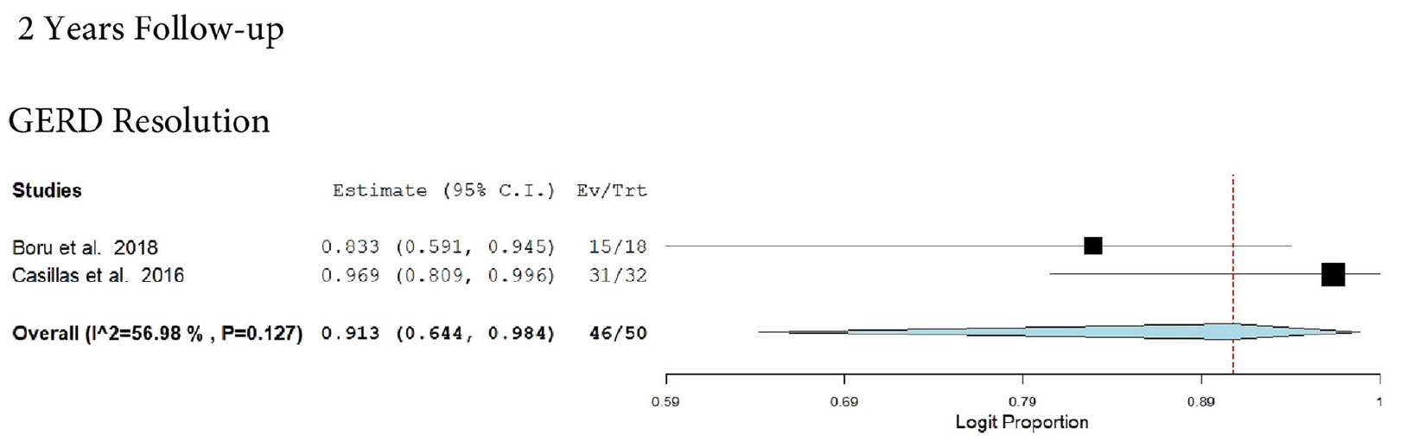
SG TO RYGB FOR GERD (2)
17 PAPERS
556 REVISIONAL RYGB (FROM SG)
30.4% INDICATIONS FOR CONVERSION DUE TO GERD
RESOLUTION OF GERD SYMPTOMS: 79.7% AT 1 YEAR, 91.3% AT 2 YEARS.

Slide 11
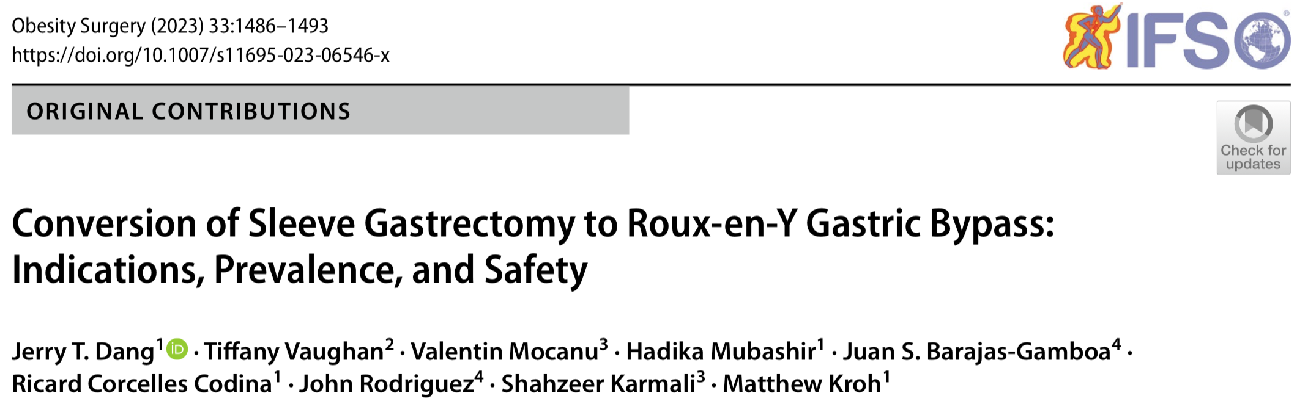
SG TO RYGB FOR GERD (3)

Slide 12
SG TO RYGB FOR GERD (4)
DATA FROM THE METABOLIC AND BARIATRIC SURGERY ACCREDITATION AND QUALITY IMPROVEMENT PROGRAM (MBSAQIP)
13432 REVISIONAL RYGB AFTER SG IN 2020-2021
INDICATIONS: GERD 55.3% (!), WEIGHT REGAIN 24.4%
30 DAYS OUTCOME: REVISIONAL RYGB ⬆ RATE OF SERIOUS COMPLICATIONS COMPARED TO PRIMARY RYGB (7.2% VS 5%), NO DIFFERENCE IN MORTALITY(0.1%)

Slide 13
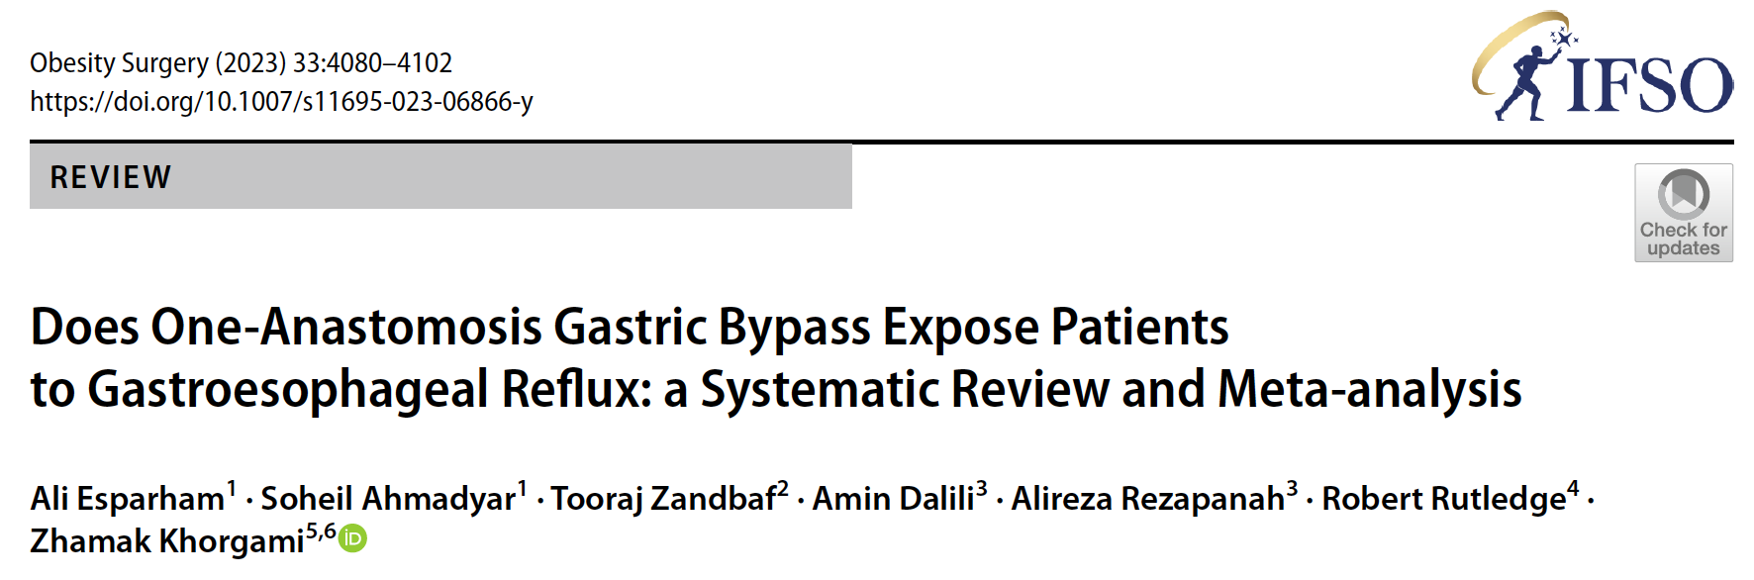
OAGB & GERD?
27775 OAGB PATIENTS → 6% RATE OF NEW-ONSET GERD (SIMILAR TO SG!)

Slide 14
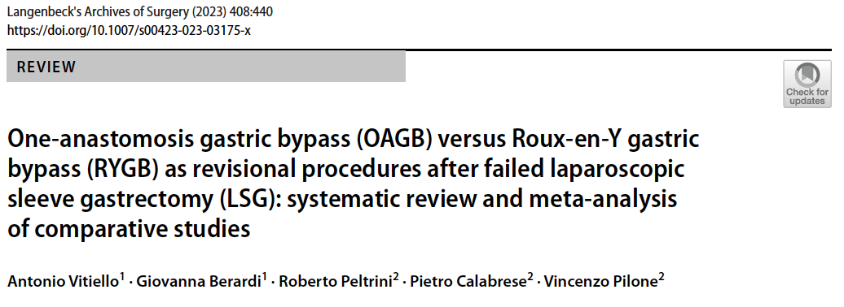
OAGB VS RYGB AFTER SG FOR GERD (1)

Slide 15
OAGB VS RYGB AFTER SG FOR GERD (2)
6 COMPARATIVE STUDIES
739 PATIENTS, 373 OAGB, 366 RYGB
GERD REMISSION: 68.6% AFTER OAGB VS 80.6% AFTER RYGB (p=0.19)
DE NOVO GERD: 6.3% AFTER OAGB VS 0.5% AFTER RYGB (p=0.16)
(WIDE HETEROGENEITY)

Slide 16
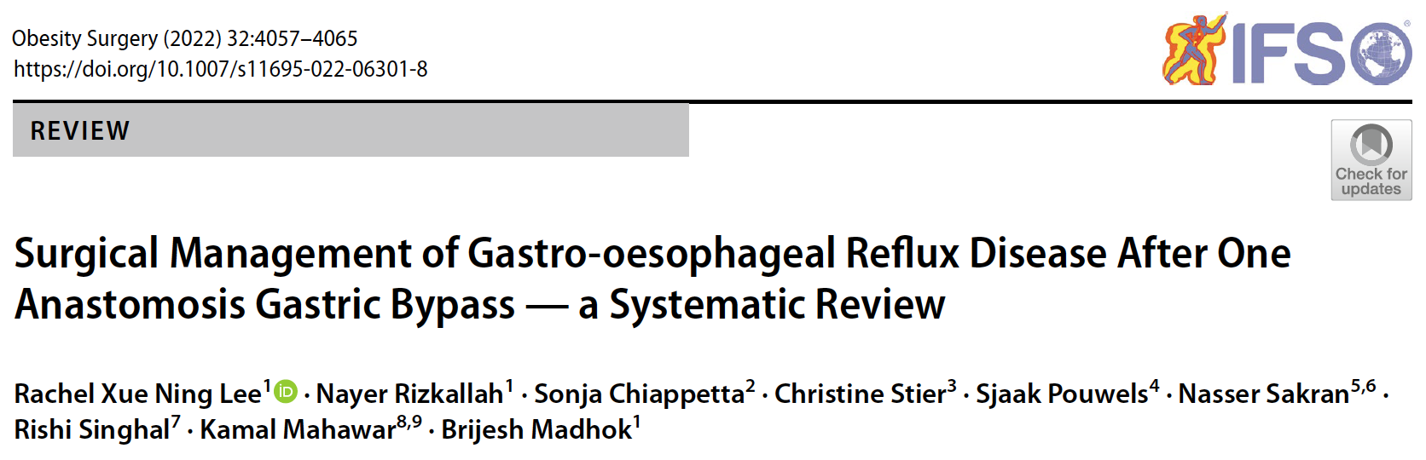
OAGB TO RYGB FOR GERD (1)

Slide 17
OAGB TO RYGB FOR GERD (2)
21 STUDIES
13658 OAGB
230 (1.6%) TREATED FOR GERD AFTER OAGB
SURGICAL REVISION: 211 (91.7%) RYGB
GERD RESOLUTION: 48.6%, (NOT REPORTED IN 45.6%)

Slide 18
SICOB SURVEY (1)
NELLA TUA ESPERIENZA, QUANTI SONO GLI INTERVENTI DI CHIRURGIA DI REVISIONE EFFETTUATI OGNI ANNO?
FRA GLI INTERVENTI DI CHIRURGIA DI REVISIONE CHE EFFETTUI, QUANTI SONO QUELLI PER GERD?
IN CHE PERCENTUALE LA TUA PROCEDURA DI SCELTA è RAPPRESENTATA DA RYGB (O SUE VARIANTI)
IN CHE PERCENTUALE TALE INTERVENTO RISOLVE IL GERD
85 PARTECIPANTI

Slide 19
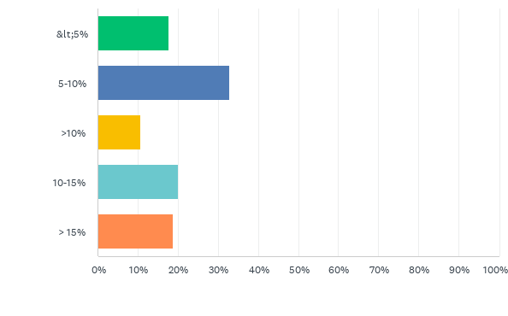

SICOB SURVEY (2)
D1: NELLA TUA ESPERIENZA, QUANTI SONO GLI INTERVENTI DI CHIRURGIA DI REVISIONE EFFETTUATI OGNI ANNO?
Risposte: 85 Saltate: 0
MEDIA ESTRAPOLATA: 9.7% ± 3.5

Slide 20
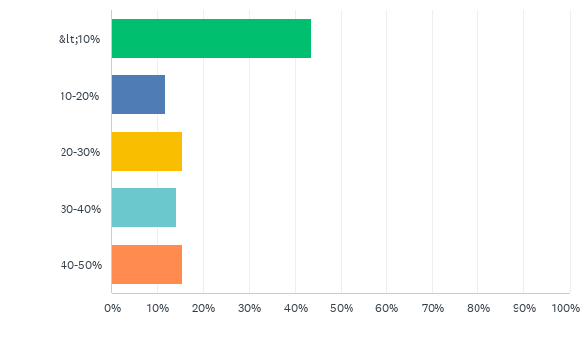
SICOB SURVEY (3)
D2: FRA GLI INTERVENTI DI CHIRURGIA DI REVISIONE CHE EFFETTUI, QUANTI SONO QUELLI PER GERD?
Risposte: 85 Saltate: 0
MEDIA ESTRAPOLATA: 20.67% ± 14.2

Slide 21
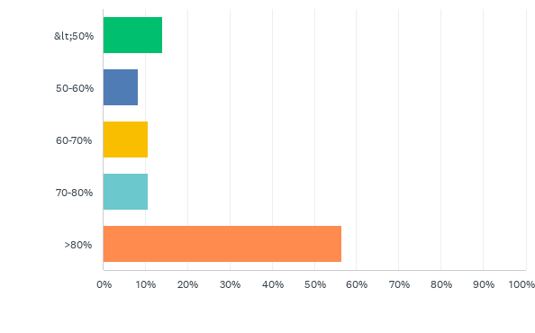
SICOB SURVEY (4)
D3: IN CHE PERCENTUALE LA TUA PROCEDURA DI SCELTA È RAPPRESENTATA DA RYGB (O SUE VARIANTI)
Risposte: 85 Saltate: 0
MEDIA ESTRAPOLATA: 74.4% ± 24.1

Slide 22
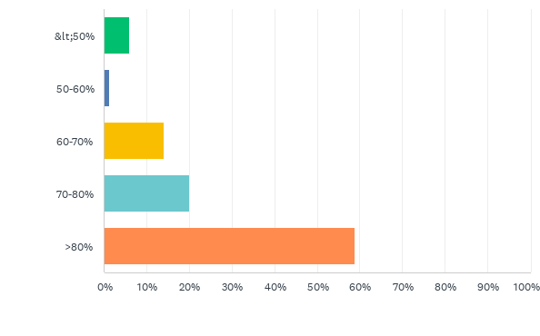
SICOB SURVEY (5)
D4: IN CHE PERCENTUALE TALE INTERVENTO RISOLVE IL GERD
Risposte: 85 Saltate: 0
MEDIA ESTRAPOLATA: 79.58% ± 18.65

Slide 23
CONCLUSIONS
GERD AFTER BARIATRIC SURGERY: MAJOR CONCERN, UP TO 50% OF INDICATION FOR REVISION (FIRST CAUSE OF RBS?).
SG MAIN CAUSE OF POST-OPERATIVE GERD (UP TO 80% OF PRIOR OPERATION)
RYGB REPRESENTS THE PROCEDURE OF CHOICE, UP TO 89% OF RBS FOR GERD
R-RYGB ⬆ RISK OF COMPLICATIONS (7.2% VS 5% RYGB), NO DIFFERENCE IN MORTALITY
RATE OF GERD RESOLUTION UP TO 90% WITH RYGB

Slide 24

GRAZIE!
DOTT. GIACOMO PIATTO
U.O.C. CHIRURGIA GENERALE E D’URGENZA
OSPEDALE “SAN VALENTINO”
MONTEBELLUNA (TV)
giacomo.piatto@aulss2.veneto.it

Slide 25
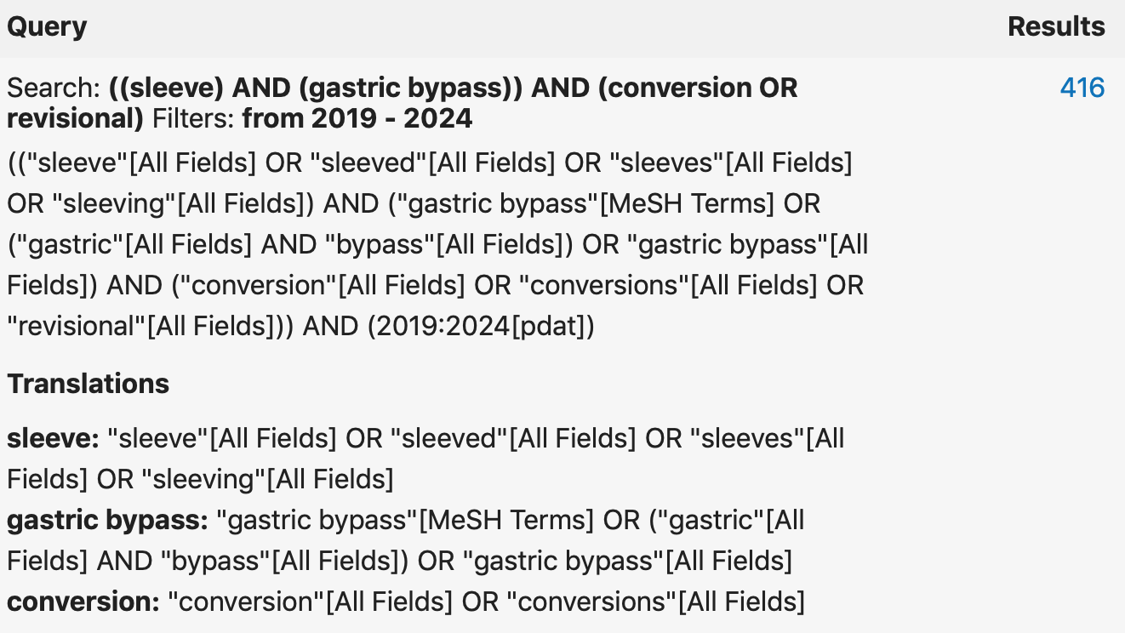
ADDITIONAL MATERIAL (1)

Slide 26
ADDITIONAL MATERIAL (2)
WARNING!
20 PAPERS FOCUSED ON WL EVEN IF INDICATION WAS GERD: EXCLUDED

Slide 27
ADDITIONAL MATERIAL (3)
RESULTS (1)
16 PAPERS
18060 R-RYGB AFTER SG FOR GERD
433 R-RYGB AFTER SG FOR GERD WITH MEAN F-UP 26.7 ± 16.18 MONTHS (13 PAPERS) FOCUSED ON GERD OUTCOME
17627 R-RYGB AFTER SG FOR GERD WITH 30 DAYS F-UP (MBSAQIP Registry) FOCUSED ON COMPLICATIONS (3 PAPERS)

Slide 28
ADDITIONAL MATERIAL (4)
RESULTS (2)
TYPE OF ASSESSMENT OF GERD BEFORE REVISION (AFTER SG):
  SYMPTOMS (+ PPI USAGE): 100%
  ENDOSCOPY: 75.3% (WIDE ETEROGENITY 0-100%)
  UGI SERIES: 40.4% (WIDE ETEROGENITY 0-100%)
  pH-METRY: 8.5%
  MANOMETRY: 17.1%

Slide 29
ADDITIONAL MATERIAL (5)
RESULTS (3)
GERD RESOLUTION: COMPLETE 83.7%
TYPE OF ASSESSMENT OF GERD AFTER REVISION (AFTER R-RYGB):
  NOT REPORTED IN 23% STUDIES (3/13)
  SYMPTOMS (+ PPI USAGE): 100%
  ENDOSCOPY: 32.9%
  UGI SERIES: 6%
  pH-METRY: 11.2%
  MANOMETRY: 12.1%

Slide 30
ADDITIONAL MATERIAL (6)
CONCLUSIONS (1)
PREOPERATIVE ASSESSMENT OF GERD AFTER SG → MAINLY SYMPTOMS AND ENDOSCOPY (POOR ROLE OF PH-MANOMETRY)
POSTOPERATIVE ASSESSMENT OF GERD AFTER R-RYGB → ALMOST EXCLUSIVELY SYMPTOMS!
ABSENCE OF STANDARDIZED PRE-REVISION PROTOCOLS
ABSENCE OF STANDARDIZED POST-REVISION PROTOCOLS

Slide 31
ADDITIONAL MATERIAL (7)
CONCLUSIONS (2)
SG → MOST PERFORMED BARIATRIC PROCEDURE WORLDWIDE
INTRACTABLE GERD AFTER SG IS A MAJOR CONCERN, UP TO 50% OF INDICATIONS OF REVISION
R-RYGB RESOLVES UP TO 83% OF GERD, BUT..
STRONG NEED OF PRE- AND POST-REVISION ASSESSMENT PROTOCOLS (APPROVED BY SURGICAL SOCIETIES)

